Slide 1
New GSKY Client Software Apps
Exploring client apps other than TerriaMap
Copyright © 2019 by National Computational Infrastructure, Canberra, ACT, Australia. All Rights Reserved.
Author: Arapaut V. Sivaprasad.
Created: 11 March, 2019

Slide 2
Objectives
TerriaMap is the only tested client for GSKY
Less known to the wide world
Explore how GSKY can be used with other clients
Create examples and tutorials
Implement a DAP service in GSKY
Next: Potential GSKY Clients

Slide 3
Potential GSKY Clients
Application | Comments | GSKY
ArcGIS | Most widely used GIS software | Works on 4 out of 6 App variants
QGIS | Widely used and VDI-integrated | Works on v3.4
AUSGIN | Australian Geoscience Information Network | Works on Production GSKY server
NASA World View (Web) | Not directly suitable for GSKY | No WMS layer addition facility
NASA World Wind (App) | Not directly suitable for GSKY | No WMS layer addition facility
NASA World Explorer (Web) | Powered by NASA World Wind | Works on Production GSKY server
NASA Web World Wind (Web) | Powered by NASA World Wind | Works on Production GSKY server Can build our own web apps.
Auscope | Parallel service to AusGIN | Works on Production GSKY server
Google Earth | Very popular software | WMS facility does not work
Next: Potential Clients Described

Slide 4

Potential Clients Described
Claimed to be “the world's most powerful mapping and analytics software”
Commercial app from Environmental Systems Research Institute (ESRI)
Six different apps in the suite.
All except one are Windows’ apps.
One online version.
No Mac version.
ArcGIS Pro and ArcGIS have several tools and analyses to help extend the usability of GSKY. For example, the “Living Atlas” has a large number of publicly available maps that can be layered over the GSKY layers for comparison analysis.
There are input tools to retrieve info from the map. For example, ‘Viewshed’ returns polygons of visible areas for a given set of input points.
This tutorial does not have the scope of understanding the whole set of tools and analyses options. However, it would be useful to work out which of these will be relevant to GSKY and create descriptive tutorials on them. Perhaps we may modify GSKY to create the data required for some analyses.
The possibilities are virtually endless if we can somehow integrate GSKY with ArcGIS Pro/Online.
ArcGIS Pro
Most comprehensive app in the suite.
Works well with GSKY.
ArcGIS Online
Online version of ArcGIS Pro.
Not as comprehensive as the desktop version.
Works well with GSKY on production server.
ArcGIS Earth
Relatively simpler to learn.
Alternative to Google Earth for corporate users.
Works with GSKY but has errors.
Next: Other ArcGIS Apps

Slide 5
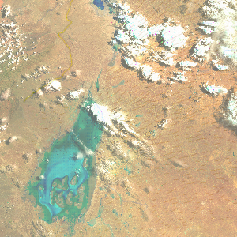
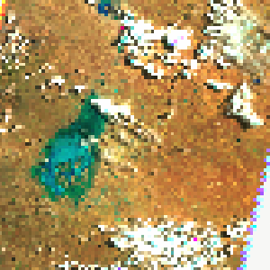
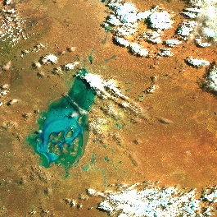
Other ArcGIS Apps
These are similar software and share the data between them.
Only ArcMAP is working with GSKY.
ArcMap
No-frills app within the ArcGIS suite
Works well with GSKY
Low picture quality
TerriaMap
ArcMap
ArcGlobe
Do as below to see the higher resolution image.
For ArcGIS Pro/Map:
Display the layer in full window mode.
Center the area to be viewed.
Go out of full window mode.
Click and drag the window as small as possible without losing the required area.
Unlike in other apps, where resizing also resizes the image, here the image will stay at the same size but becomes higher resolution.
Pan the image slightly so hat it is redrawn.
Disadvantage is that you can only see a small section at a time.
3D base map.
Does not add the GSKY layer
Maybe fixable
ArcScene
No base map (?!)
Does not add the GSKY layer
Maybe fixable
ArcMap – small canvas
Next: ArcGIS Alternatives

Slide 6
ArcGIS Alternatives
There are several free alternatives to ArcGIS.^{[Ref]}
Not explored
Probably low user base
GRASS
Developed under US Govt grant in 1982
Python console
uDIG
Public domain program
gvSIG
Public domain program
Next: ArcGIS Pro Desktop

Slide 7
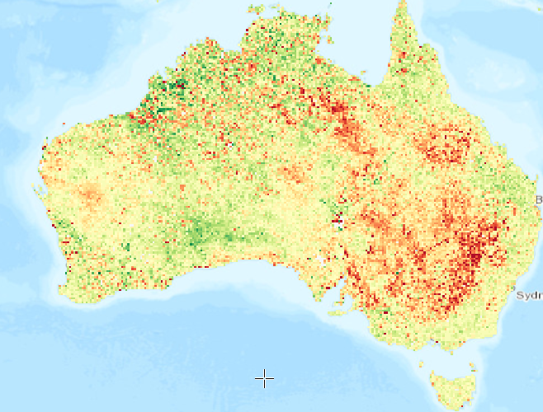
ArcGIS Pro Desktop App
ArcGIS Pro
Tutorial: https://github.com/.../ArcGIS_Pro_Desktop_Tutorial.pptx
Installation, activation and configuration.
Add GSKY Web Map Service.
Advanced use of ArcGIS Pro using an example.
Dozens of free public domain layers and base maps.
e.g. Natural water layer, buildings, roads, forests, MacDonalds!
Attribute tables and many analysis methods.
Python console and built-in tools.
Learning this app fully is about as easy as escaping from the path of a cyclone.
Next: ArcGIS Online

Slide 8
ArcGIS Online
ArcGIS Online
Tutorial: https://github.com/.../ArcGIS_Online_Tutorial.pptx
Requires an ArcGIS Online account (ANU Institutional Licence)
https://www.arcgis.com/home/index.html
It has many features of ArcGIS Pro and is platform independent.
Publish your work:
ArcGIS Online has a facility to publich your maps and layers on the ArcGIS server so that others can view and work with them.
Publishing your work requires a licence that has ‘Publish’ privileges. When you apply for an ANU Organisational licence you will get an ‘ANUStandard’ account which does not have this privilege. You must request for an upgrade to ‘ANUPublisher’ or ‘ANUStudent’ level.
FSES is reluctant to give ANUPublisher account but may give ANUStudent account if you ask very politely, gently and saying how much obliged you will be, etc. (: So far, my account is the only one with an ANUStudent status across all of ANU and there is no ANUPublisher.
There is a nominal cost involved in publishing. It is deducted from your ‘available credit’ that comes with the account. Unsure as yet how to apply for more credits.
Simple Use:
Create a map
Add a layer
Set map for share
Advanced Use:
Add demographic data
Style the layer with attribute data
Normalise the style data
Customise the Pop-up
Create a web App and share its URL
Add GSKY Web Map Service…
Works well with GSKY on production server.
Next: ArcGIS Earth

Slide 9

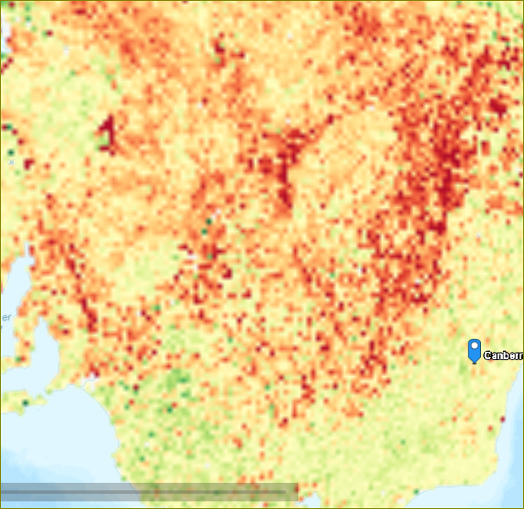
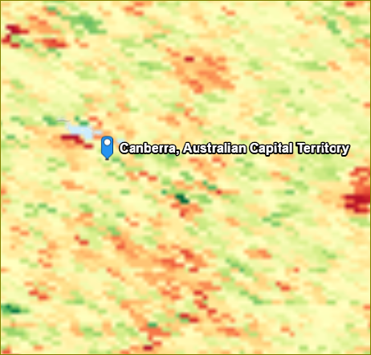
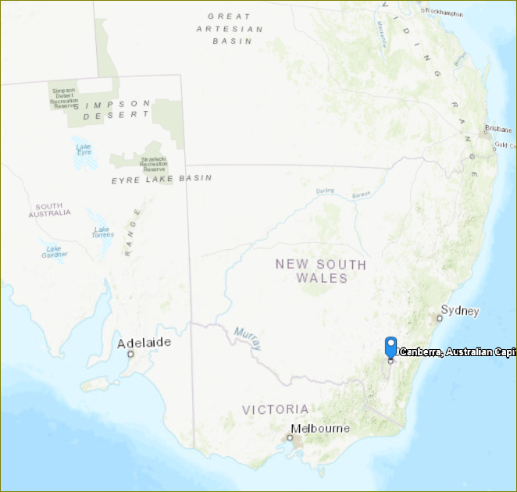
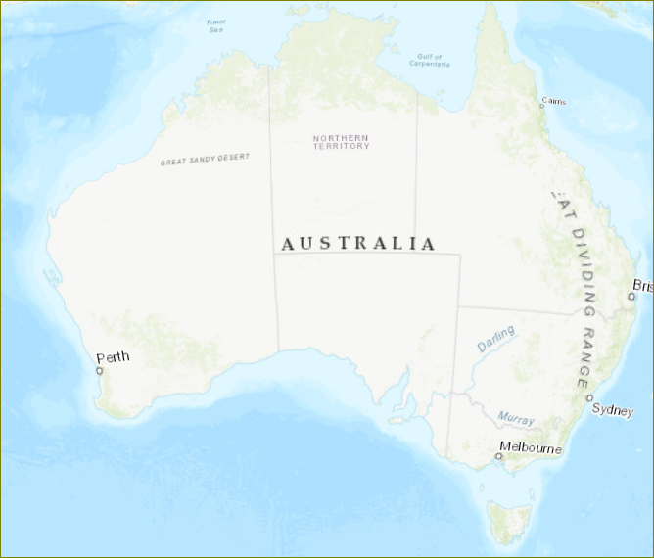
ArcGIS Earth
ArcGIS Earth
Tutorial: https://github.com/…/ArcGIS_Earth_Tutorial.pptx
Requires an ArcGIS Desktop Advanced Licence.
Requires additional step to install.
Windows desktop only.
Much simpler to use than others.
Alternative to Google Earth.
Only 3D map is available.
Add GSKY Web Map Service…
Works with GSKY but goes blank at lower zoom levels.
The layer disappears. This needs to be looked at in GSKY code. Looks like the zoom limit changes somehow.
Next: Google Earth

Slide 10

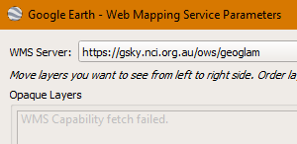
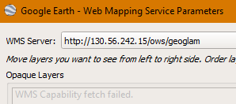
Google Earth
Google Earth
Tutorial: Not yet done.
Free software from Google.
The WMS service is not working with Google Earth (GE), and it appears to be a general issue than specific to GSKY. None of the example URLs they have included in the program works either.
It is calling the GSKY server with the following query:
query: map[version:[1.1.1] request:[GetCapabilities] service:[WMS]]
GSKY server is processing the query without any error. However, GE interprets the return value as error and says “WMS Capability fetch error”. Hence, no further calls to ‘service=WMS’ is arriving.
Perhaps we could try to get some help through the Google Developer’s forum. Will investigate and post here later.
Very widely used.
Has WMS capability.
Not connecting to GSKY servers yet.
query: map[service:[WMS] version:[1.1.1] request:[GetCapabilities]]
Next: QGIS

Slide 11


QGIS
QGIS
Tutorial: https://github.com/.../QGIS_Desktop_Tutorial.pptx
Free and open source program.
Windows, Mac and VDI versions.
QGIS is almost as comprehensive as ArcGIS Pro and is a free software. It can be installed on Mac as well as on Windows and Linux.
There is a VDI-integrated version as well. However, there are issues.
The v2.14 does not work with GSKY.
The v3.4 is currently having issues, which will be fixed. As a workaround, it is possible to start it as commandline in an SSH session. It will be documented in the above tutorial.
About as complex as ArcGIS Pro.
Large number of options and settings.
Add GSKY Web Map Service…
Works well with GSKY.
Only the latest version, 3.4.x, works with GSKY.
Next: AusGIN

Slide 12
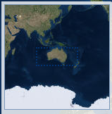

AusGIN
AUSGIN
Tutorial: Not yet done.
Free and web based service.
Provided by Geoscience and various Australian state governments.
This is somewhat like TerriaMap. There are five base maps to choose from and the layers get added relatively quickly. Almost as good user experience as TerriaMap. No analysis facilities and tools like in ArcGIS.
Layers and text data can be published by asking them. Unsure how/whether it can be done.
Pre-made layers.
Facility to add own layers.
WMS layer facility.
http://portal.geoscience.gov.au/
Add GSKY Web Map Service…
Works well with GSKY on production server.
Next: Auscope

Slide 13
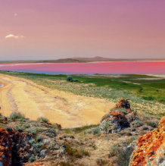

Auscope
Auscope
Tutorial: Not yet done.
Free and web based service.
Based in Uni of Melbourne and funded by NCRIS.
This is somewhat like TerriaMap and AusGIN. There is only a simple base map with no option to change it. Almost as good user experience as TerriaMap. No analysis facilities and tools like in ArcGIS.
Layers and text data can be published by asking them. Unsure how/whether it can be done.
Pre-made layers.
Facility to add own layers.
WMS layer facility.
http://portal.auscope.org.au/
Add GSKY Web Map Service…
Works well with GSKY on production server.
Next: NASA World Wind

Slide 14


NASA World Wind
World Wind
Tutorials: NASA_WebWorldWind.pptx, NASA_WebWorldWind_DEA.pptx, NASA_WebWorldWind_DEA_KML.pptx
Free and open source program.
Maps and layers provided by various organisations.
Build your own 3D globe application from the SDK.
Make and publish your map on World Wind servers.
https://worldwind.arc.nasa.gov/
World Wind project will be suspended from April 5, 2019.
This will affect only the base maps. Changing to Bing maps.
Adding GSKY Web Map Service…
May have to ask NASA to publish our data.
Next: NASA World View

Slide 15

NASA World Wind
NASA Explorer
Tutorial: Not done.
Free and open source program.
Maps and layers provided by various organisations.
The WorldWind Explorer powered by NASA WorldWind
Works with GSKY
https://worldwind.earth/explorer/
Adding GSKY Web Map Service…
Works well with GSKY on production server
Next: NASA Web World Wind

Slide 16

NASA Web World Wind
NASA Web World Wind
Tutorial: To be Done.
Free and open source program.
Maps and layers provided by various organisations.
https://worldwind.arc.nasa.gov/web/
The Web WorldWind powered by NASA WorldWind
Works with GSKY
Can build our own web app with hard coded GSKY layers
Adding GSKY Web Map Service…
Works well with GSKY on production server
Next: NASA World View

Slide 17

NASA World View
World View
Tutorial: Not done.
Free online service.
Maps and layers provided by various urganisations.
https://worldview.earthdata.nasa.gov/
Online service to publish maps and layers.
Make and publish your map on World View servers.
Adding GSKY Web Map Service…
No facility to add external WMS service.
Services and layers are pre-published.
Next: DAP Service in GSKY

Slide 18

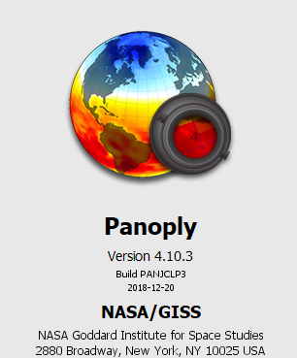

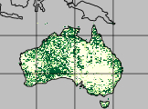
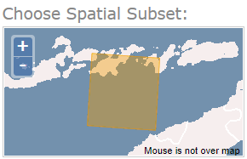
DAP Service in GSKY
GSKY can aggregate NetCDF files
DAP can deliver them to other software for analyses
So, let us combine the two features !
First step:
Create an aggregate output file in NetCDF format
Open it in Panoply or Python Notebook - OK
The objective is to provide a facility to take advantage of the speed of GSKY in collecting the data and creating an aggregate file for analysing the data using other DAP clients a user is familiar with. Python will be the major analysis tool.
Currently Python can read a NetCDF file or a DAP URL to it. It can only handle a single NetCDF file which, though can have multiple time layers, cannot provide an aggregate data as GSKY does. We intend to replace this with a URL that points to GSKY. It should then be possible to define some params and get a datacube, instead of a single layer of time, that is comprised of the layers over a time range.
Next: Provide as NetCDF subset service
APIs to connect directly to GSKY
Send the data in DAP format
End of Slides

Slide 19
Wrappers for External Clients
Status Update on 10 October, 2019
Which are the external clients?
How do their WMS interfaces work?
Need for wrappers
Describe wrappers
Quick instructions
In-slide videos
Live demonstrations

Slide 20
Wrappers for External Clients
Four external clients
ArcGIS
QGIS – Not yet working.
Google Earth
NASA World Wind
Major problem(s) of native WMS in these clients are...
Not present in some clients. – Google Earth and NASA World Wind
Not possible to select a date of acquisition.
Display is distorted or blank.
DEA layers do not appear in any client at low zoom levels.
GEOGLAM layers are distorted when a large area is selected.
Resolution of image is poor.
DEA Layers are poor at all zoom levels.
GEOGLAM is poor on zooming in.
Not all layers are displayed via the WMS.
ArcGIS Earth shows only the topmost layer.
Wrappers solve all the above issues and make it a seamless process.
A negative aspect of wrapper is that it adds an extra interface for working with GSKY.
A positive is that we can publish a page without the user having to type in a WMS endpoint.

Slide 21
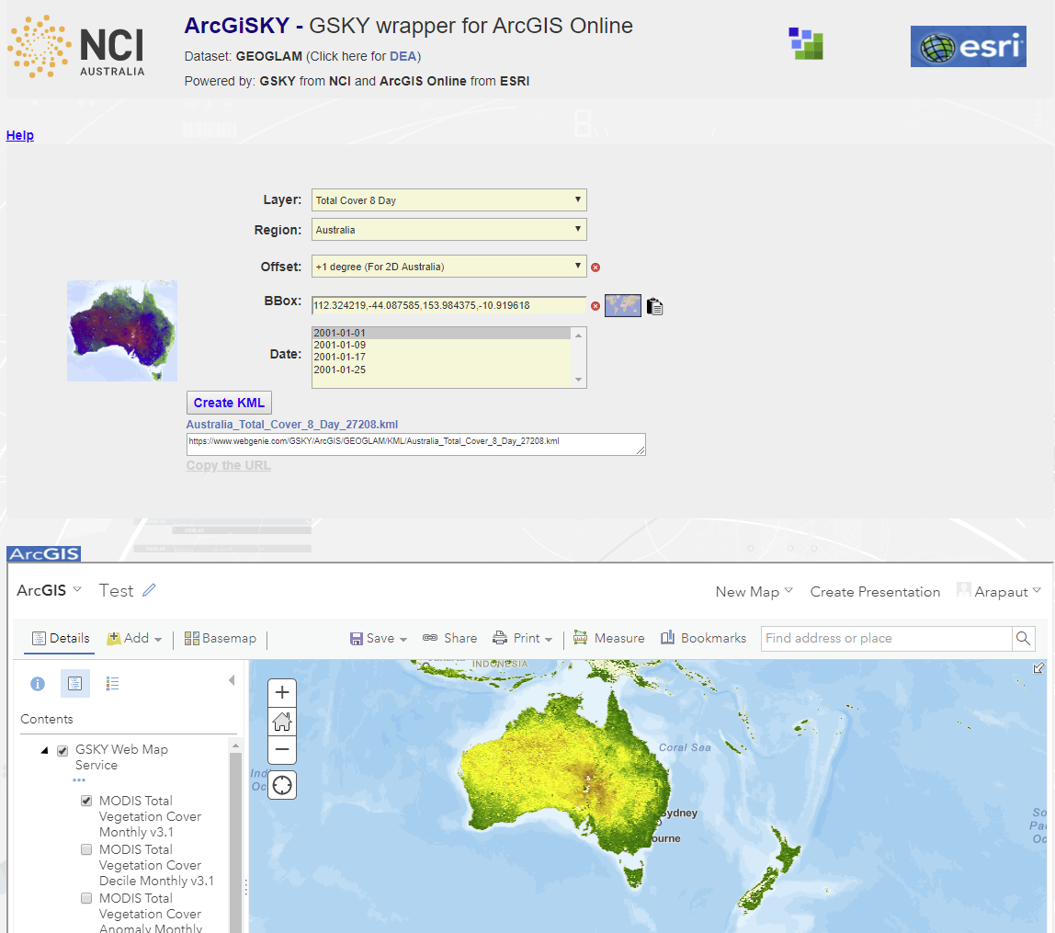
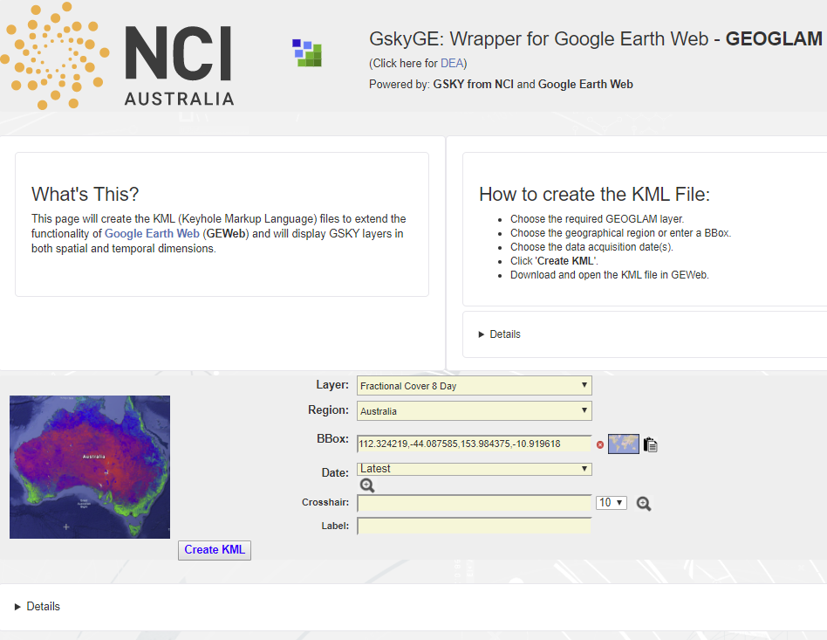
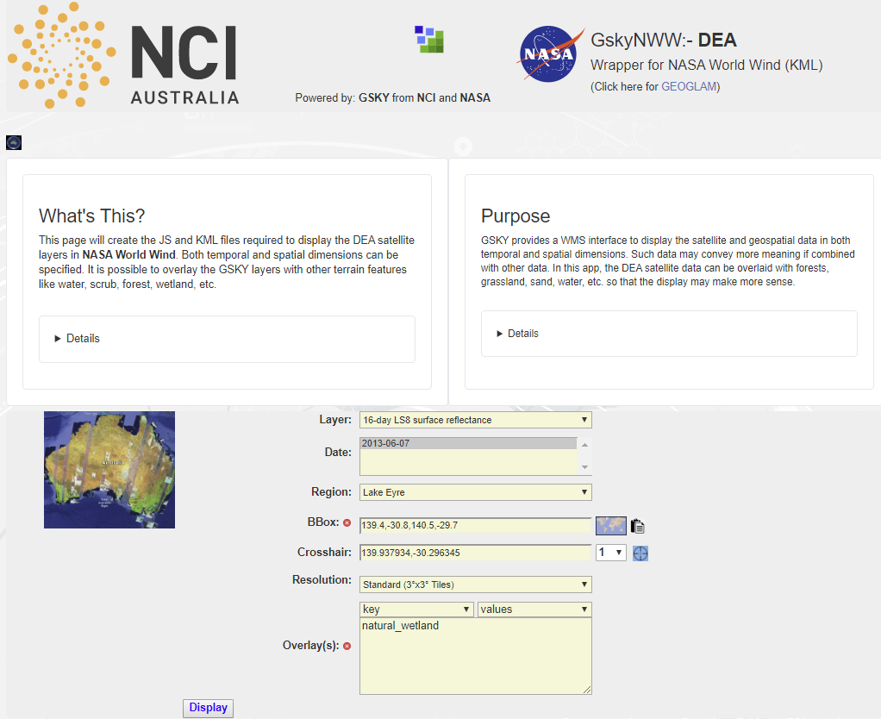
Wrappers for External Clients
ArcGiSKY – For ArcGIS Online, Explorer, and Earth
GSKYge – For Google Earth Online and Pro
GSKYnww – For NASA World Wind
Wrappers are web interfaces that create KML files for use with the clients.
KMLs are interchangeable between clients, except in some cases.
Wrappers are intuitive and flatten the learning curve of using the clients.
They add functionalities that lack natively in clients.
Wrappers work on both desktop and mobiles.

Slide 22
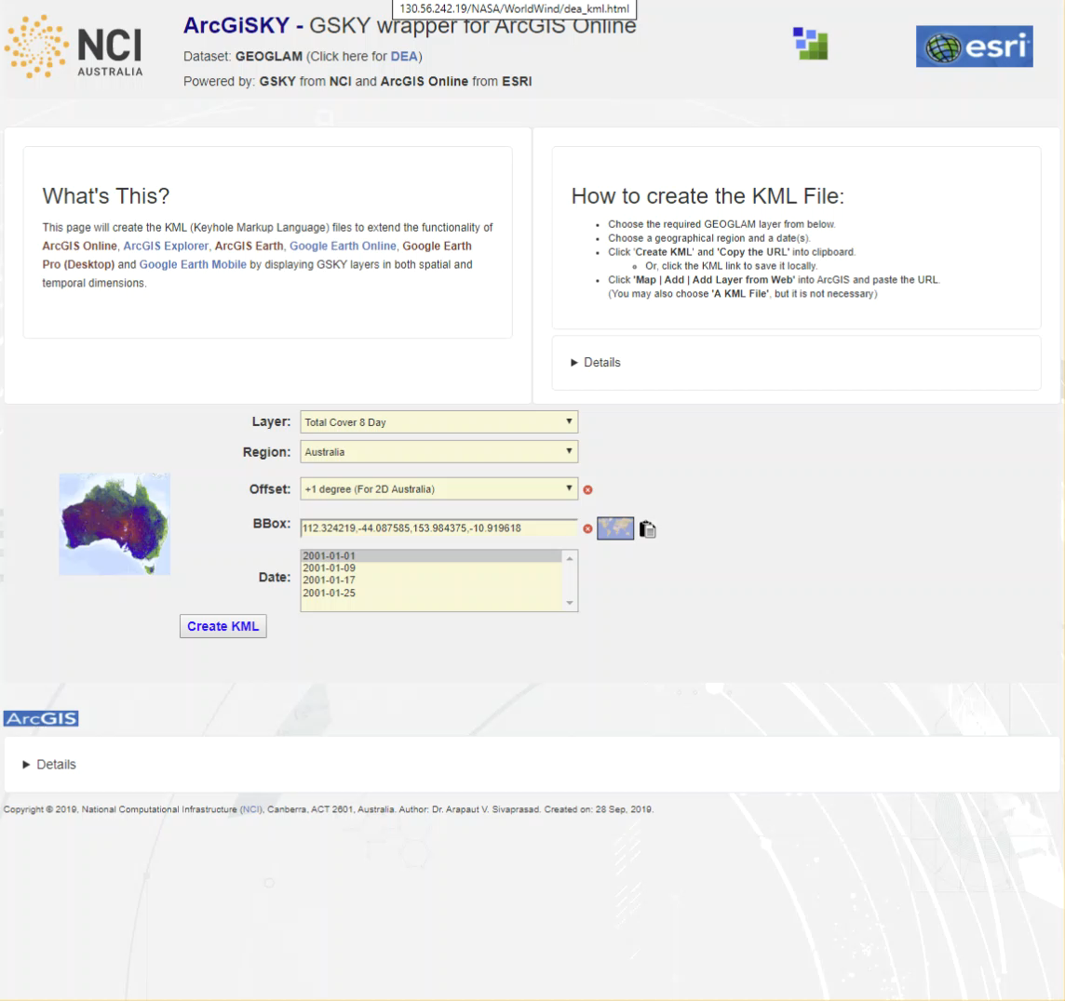
ArcGiSKY - Wrapper for GEOGLAM
ArcGiSKY – GEOGLAM
Creates KML on server and displays its URL.
This URL can be opened in ArcGIS Online/Explorer/Earth.
Single or multiple date selection.
Region selection from list or,
Specify an area by drawing a bounding box.
ArcGIS Online and Explorer can create presentations.
Requires a public webserver for the wrapper for ArcGIS Online.
Intranet webserver is OK for ArcGIS Explorer and ArcGIS Earth.
QUICK INSTRUCTIONS
Open wrapper on VM or on public (for ArcGIS Online) webserver.
Select Layer, Region and Date(s).
Click ‘Create KML’ followed by ‘Copy the URL’ or click link and save KML file.
Display in the following clients.
ArcGIS Online: Map | Add | Add Layer from Web | URL
ArcGIS Explorer: Add Content | KML Files | KML Network Link
ArcGIS Earth: Add data (+) | Enter a URL | KML File | URL
Google Earth Online: My Places | Import KML File | Open file…
Google Earth Pro: File | Open | KML File
DEMO
You can play the video on right within the editor or a slide show by moving the cursor over it and pressing the play button. Can also save it as an MP4 file and play it in any media player.

Slide 23
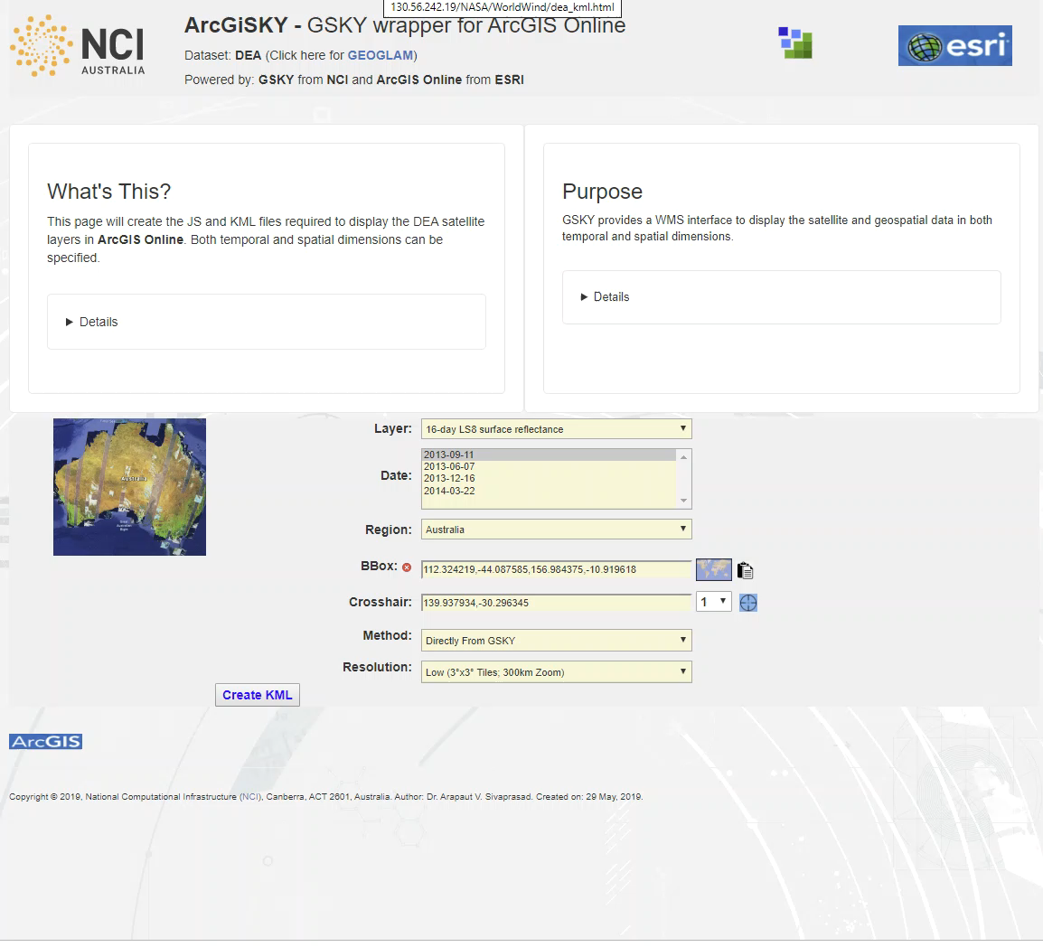
ArcGiSKY - Wrapper for DEA
ArcGiSKY – DEA
All features of GEOGLAM with some exceptions:
Only single date selection.
Data can be directly from GSKY or from cached tiles (PNG)
Accelerated pyramid is possible if it is on a public server.
Three different levels of resolution.
DEMO
QUICK INSTRUCTIONS
Open wrapper (on VM) or on public webserver for ArcGIS Online.
Select Layer, Region and Date(s).
Click ‘Create KML’ followed by ‘Copy the URL’ or click link and save KML file.
Display in the following clients.
ArcGIS Online: Map | Add | Add Layer from Web | URL
ArcGIS Explorer: Add Content | KML Files | KML Network Link
ArcGIS Earth: Add data (+) | Enter a URL | KML File | URL
Google Earth Online: My Places | Import KML File | Open file…
Google Earth Pro: File | Open | KML File

Slide 24
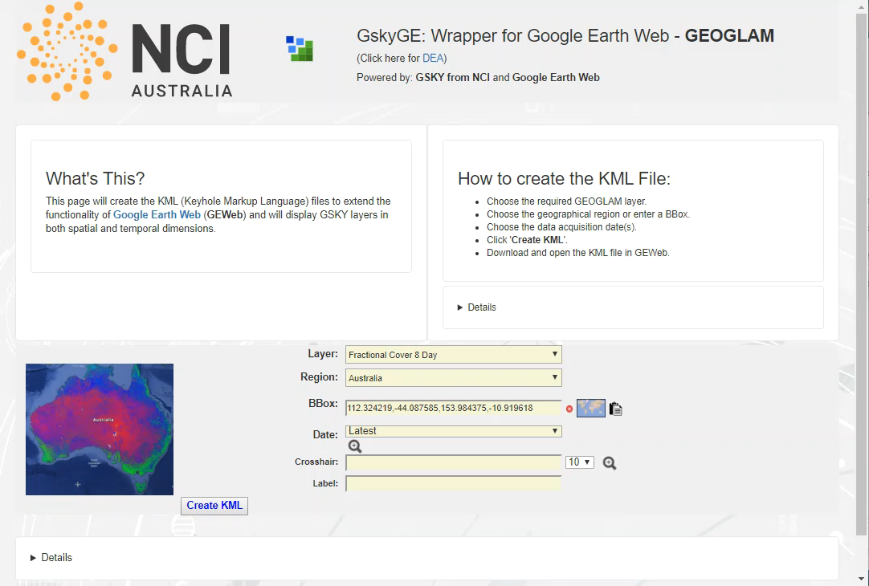
GSKYge - Wrapper for GEOGLAM
GSKYge – GEOGLAM
Creates and saves KML on server and provide download URL.
Open the downloaded KML in Google Earth.
Single or multiple date selection.
Region selection from list or,
Specify an area by drawing a bounding box.
Zoom around a crosshair.
ArcGiSKY replaces this wrapper
DEMO
QUICK INSTRUCTIONS
Open wrapper on VM.
Select Layer, Region and Date(s).
Click ‘Create KML’ and click link to save KML file.
Display in the following clients.
ArcGIS Explorer: Does not work well – To be fixed
ArcGIS Earth: Does not work well – To be fixed
Google Earth Online: My Places | Import KML File | Open file…
Google Earth Pro: Does not work well – To be fixed

Slide 25
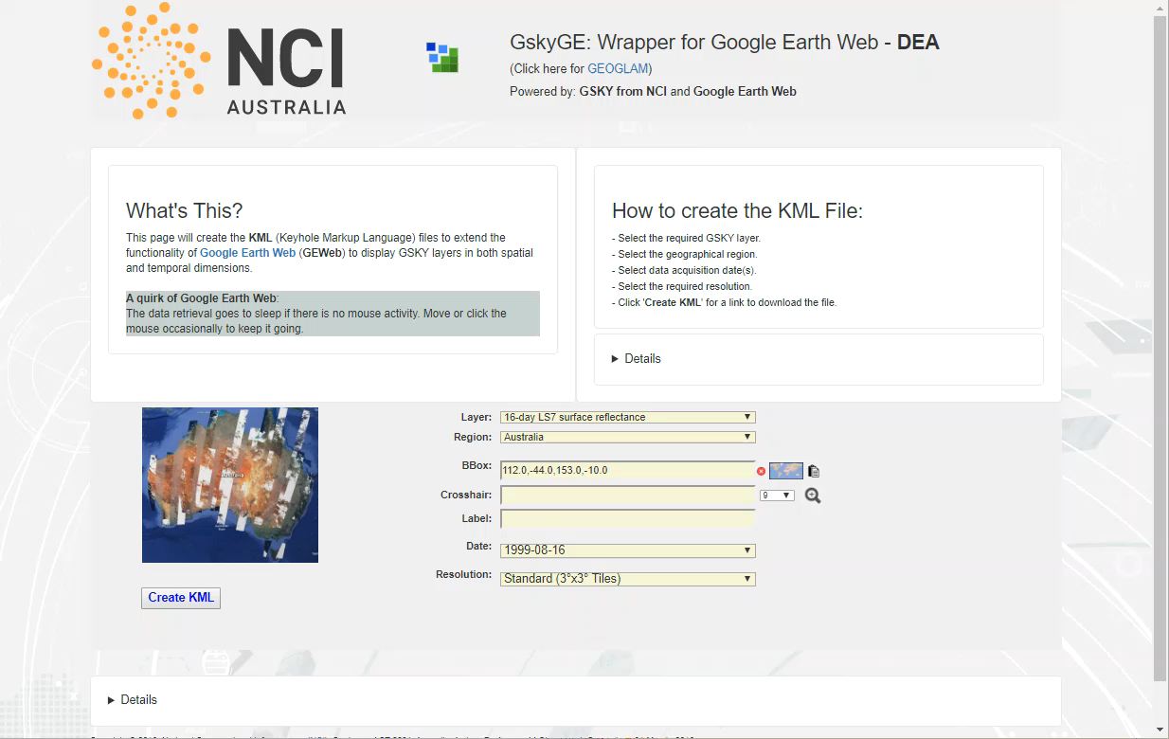
GSKYge - Wrapper for DEA
GSKYge – DEA
All features of GEOGLAM with some exceptions:
Only single date selection.
Data is directly from GSKY or cached tiles (PNG) at low resolution.
Accelerated pyramid is possible if on a public server.
Three different levels of resolution.
ArcGiSKY replaces this wrapper
DEMO
QUICK INSTRUCTIONS
Open wrapper on VM.
Select Layer, Region and Date(s).
Click ‘Create KML’ and click link to save KML file.
Display in the following clients.
ArcGIS Explorer: Does not work well – To be fixed
ArcGIS Earth: Does not work well – To be fixed
Google Earth Online: My Places | Import KML File | Open file…
Google Earth Pro: Does not work well – To be fixed

Slide 26
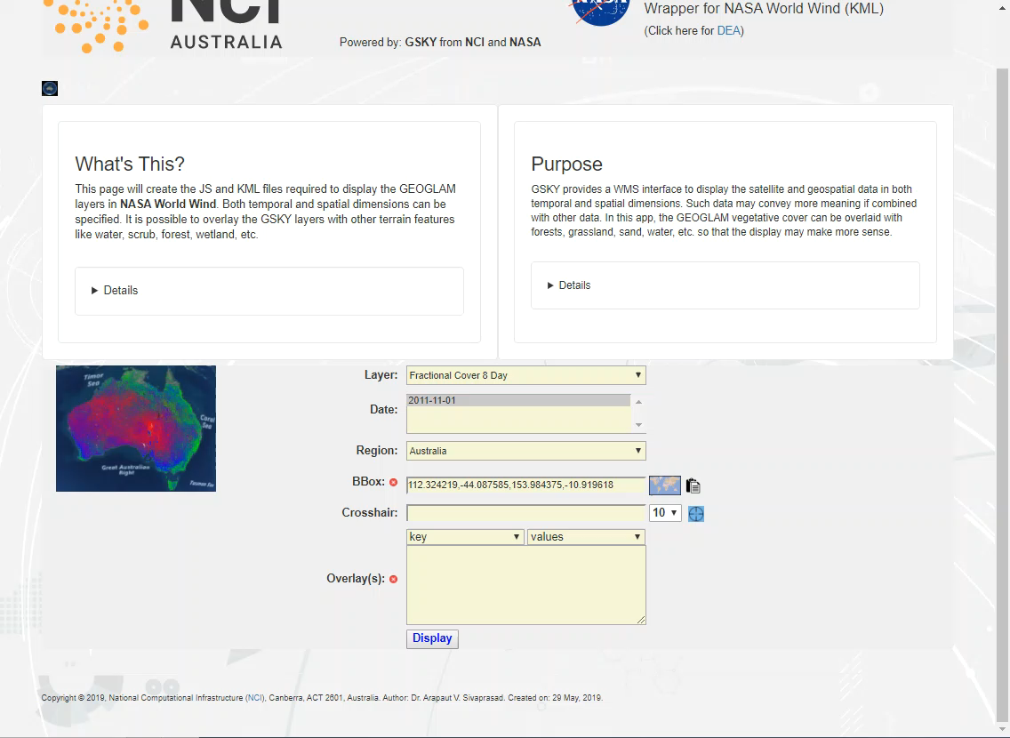
GSKYnww - Wrapper for GEOGLAM
GSKYnww – GEOGLAM
Creates and saves KML on server.
Automatically opens the KML to display.
Single or multiple date selection.
Region selection from list or,
Specify an area by drawing a bounding box.
Zoom around a crosshair.
Overlay OSM layers.
DEMO
QUICK INSTRUCTIONS
Open wrapper on VM.
Select Layer, Region and Date(s).
Click ‘Display’.
Click the link for the layer.
Check layers to be viewed.
KML is not saved for user.
Advanced Usage:
Select a Key/Value pair(s) for overlays.
Must select a smaller area to see overlays.

Slide 27
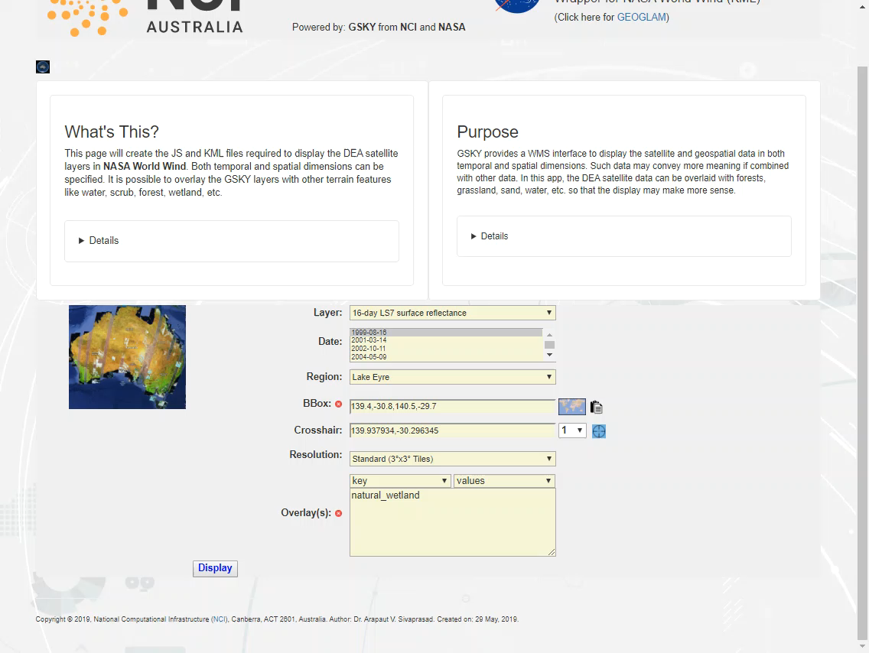
GSKYnww - Wrapper for DEA
GSKYnww – DEA
All features of GEOGLAM with some exceptions:
Only single date selection.
Data is directly from GSKY or cached tiles (PNG) at low resolution.
Accelerated pyramid is possible if on a public server.
Three different levels of resolution.
DEMO
QUICK INSTRUCTIONS
Open wrapper on VM.
Select Layer, Region and Date(s).
Click ‘Display’.
Click the link for the layer.
Uncheck tiles to be masked.
KML is not saved for user.
Advanced Usage:
Select a Key/Value pair(s) for overlays.
Must select a smaller area to see overlays.

Slide 28
Wrappers – Questions and Decisions
Are wrappers the way to use GSKY on clients?
Are there other methods, now that the PoCs are working?
If wrappers, which ones should be further refined?
What will be the user acceptance of wrappers?
Advanced usage of the clients…
Should we teach the users about the external clients?
Add extra features in the wrappers?
Enhance the resolution of GEOGLAM layers?

Slide 29
Wrappers for External Clients
yyy

Slide 30
Wrappers for External Clients
yyy

Slide 31






Acknowledgements

